Slide 1
THE PLAYLIST HTML version
FRANCESCO RITA
MATTIA CAMPANA

Slide 2
DATABASE
CONCETTUAL & LOGICAL SCHEME

Slide 3
CONCETTUAL SCHEME
UserName
Id
USER
SONG
Password
Title
0 : N
Genre
add
1:1
FileAudio
0 : N
0 : N
1:1
create
contains
belong to
1 : 1
1 : N
Name
Id
PLAYLIST
ALBUM
Title
CreationDate
0 : N
FileImage
Singer
PublicationYear

Slide 4
LOGICAL SCHEME
USER:
UserName
Password
PLAYLIST:
Name
UserName
CreationDate
CONTAINS:
PlaylistName
PlaylistUser
Song
SONG:
Id
Title
Genre
FileAudio
User
Album
ALBUM:
Id
Title
FileImage
Singer
PublicationYear
FOREIGN KEYS:
Playlist.UserName → User.UserName
Song.User → User.UserName
Song.Album → Album.Id
Contains.(PlaylistName, PlaylistUser)→ Playlist.(Name, UserName)
Contains.Song → Song.Id

Slide 5
APPLICATION DESIGN
IFML

Slide 6
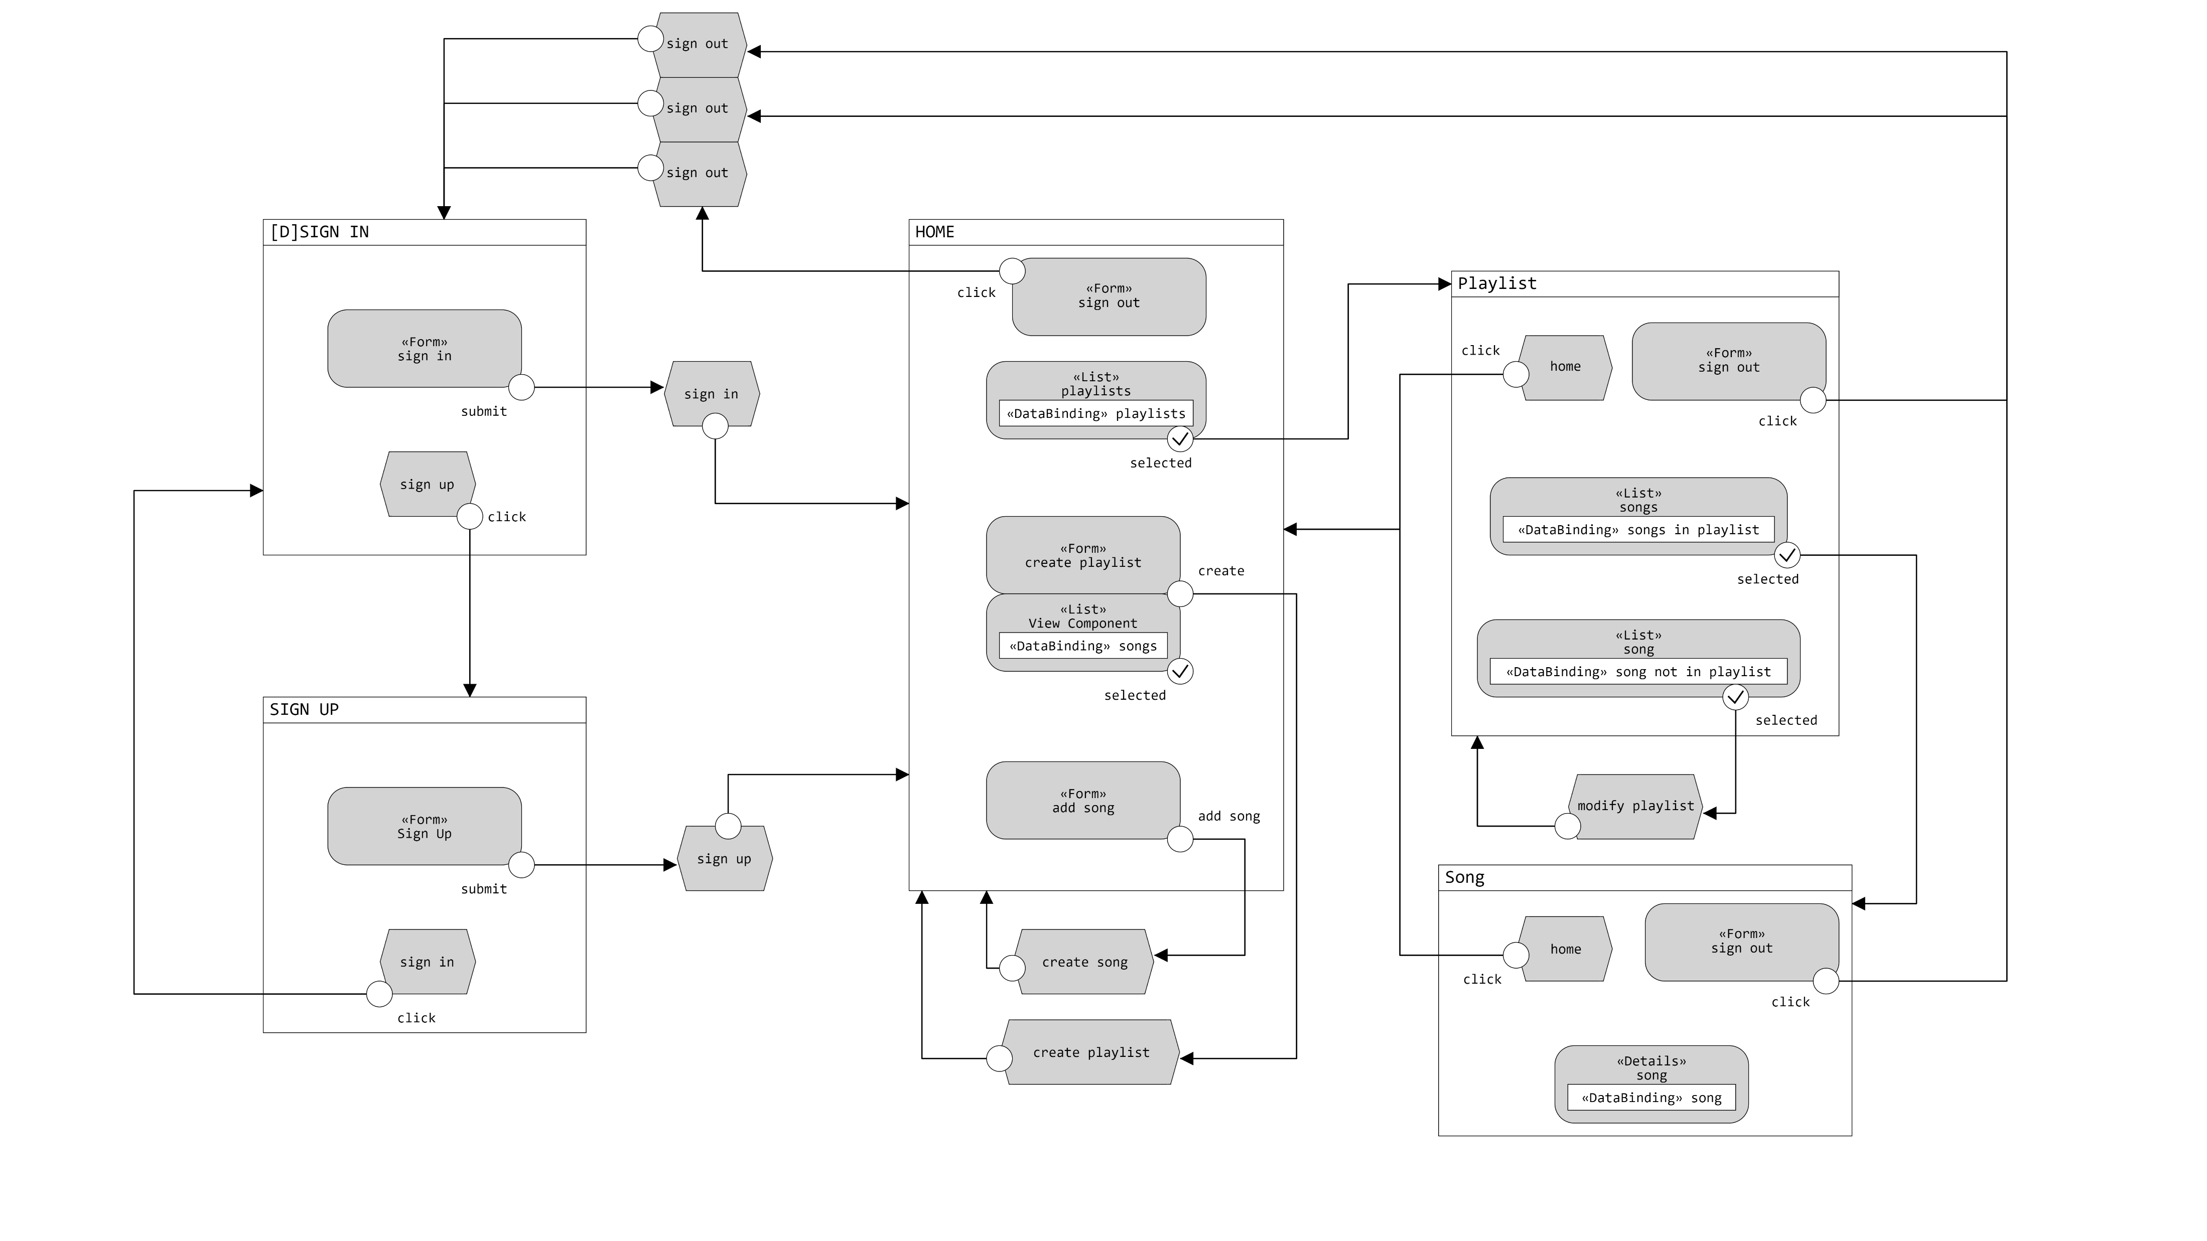

Slide 7
COMPONENTS
BEANS – DAO – SERVLETS

Slide 8
BEANS
SONG:
id: int
title: String
genre: String
fileAudio: String
album: Album
ALBUM:
id: int
title: String
fileImage: String
singer: String
year: int
PLAYLIST:
name: String
creationDate: Date

Slide 9
DAO
PLAYLIST:
addPlaylist
songAlreadyIn
addSongToPlaylist
addPlaylistWithSongs
belongTo
allPlaylists
taken
SONG:
findAlbumId
addAlbum
songAlreadyIn
addSong
addSongAndAlbum
getSongTitleAndImage
getSongsNotInPlaylist
getSongsByUser
playSong
belongTo
getNumOfSongsByUser
imgBelongTo
audioBelongTo
USER:
taken
authentication
registration

Slide 10
SERVLET
CreatePlaylistServlet
CreateSongServlet
EditPlaylistServlet
GetImageServlet
GetSongServlet
HomeServlet
PlayerServlet
PlaylisServlet
SignInServlet
SignUpServlet
SignOutServlet
FILTERS:
LoggedChecker
NotLoggedChecker
PlayerChecker
PlaylistChecker
UTILS:
ConnectionHandler
TemplateHandler

Slide 11
SEQUENCE DIAGRAM

Slide 12
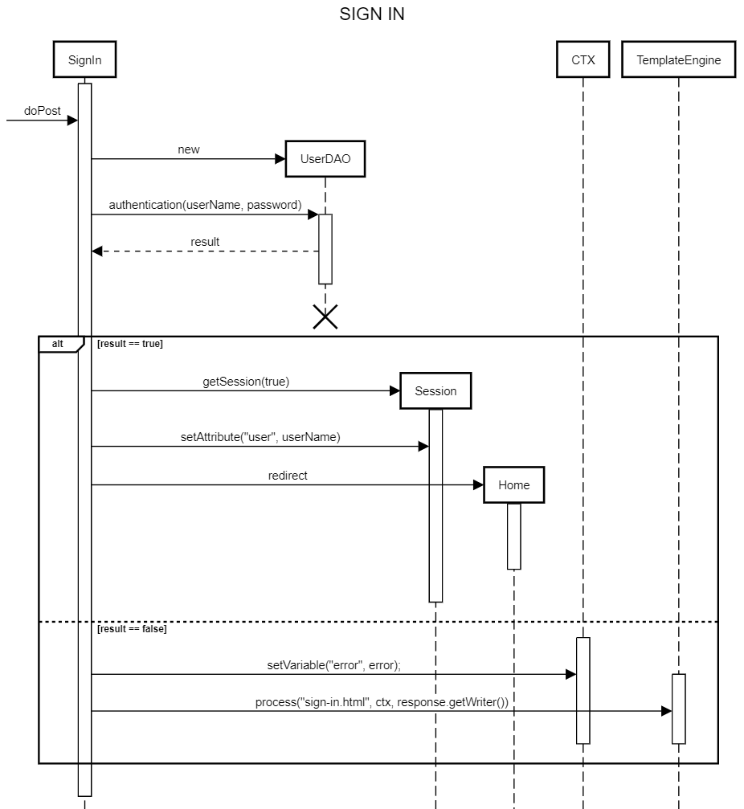
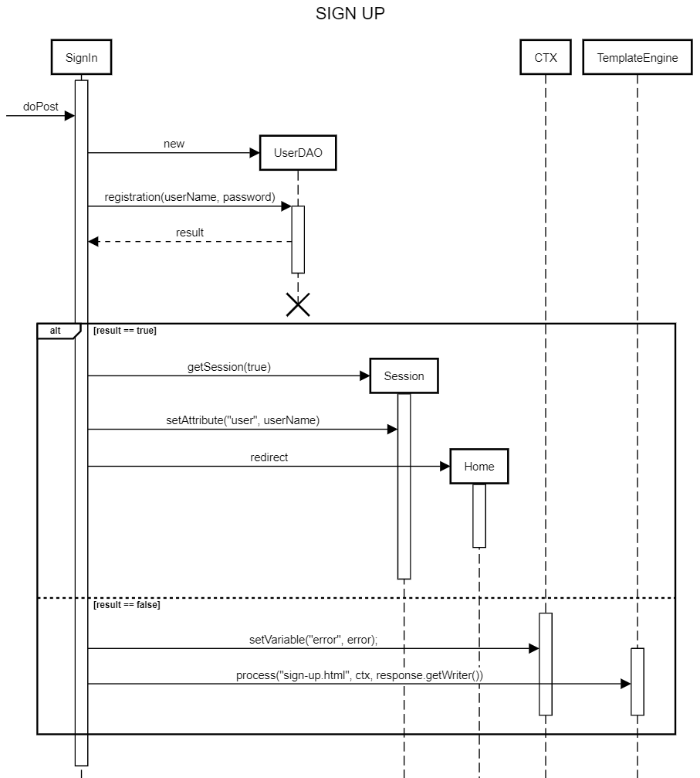

Slide 13
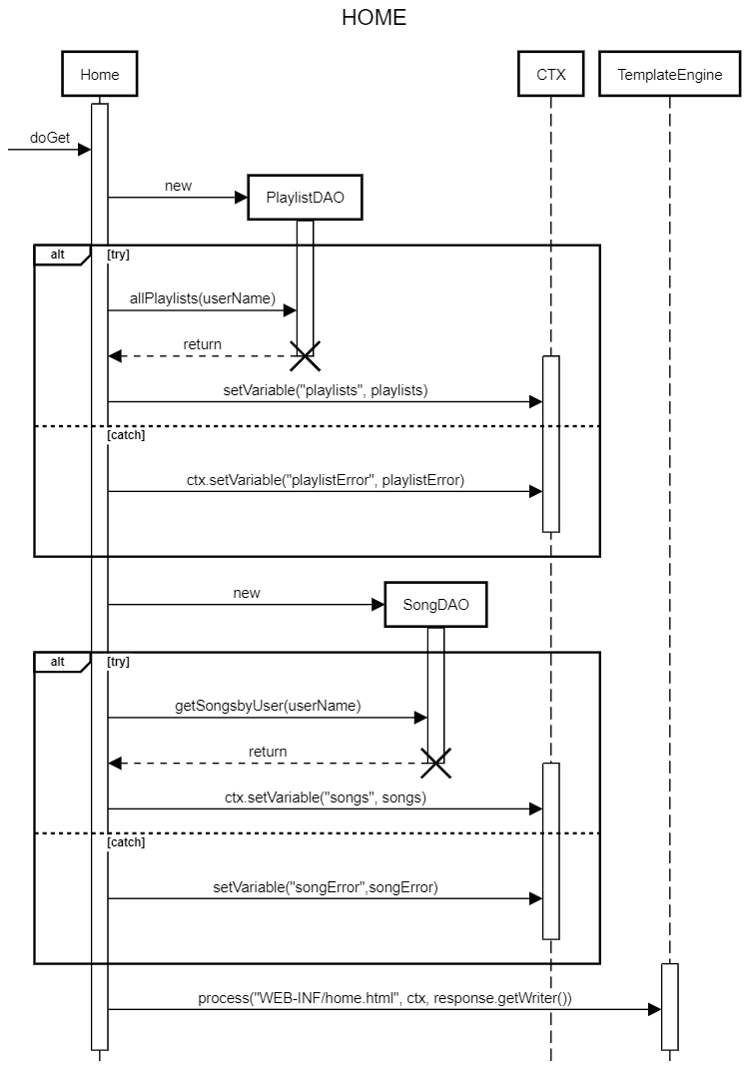
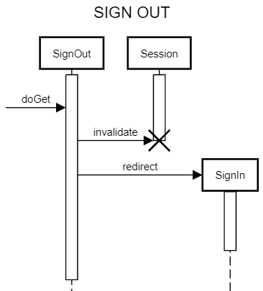

Slide 14
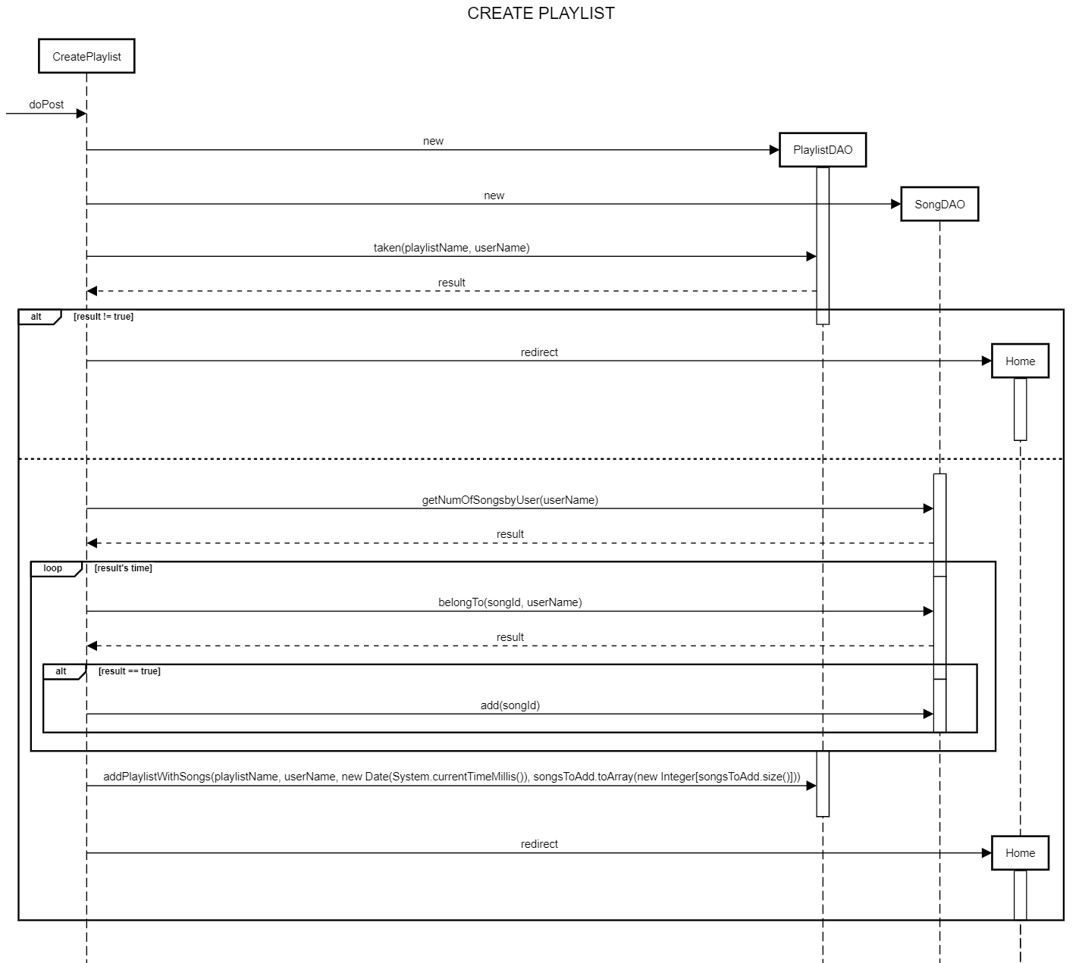

Slide 15
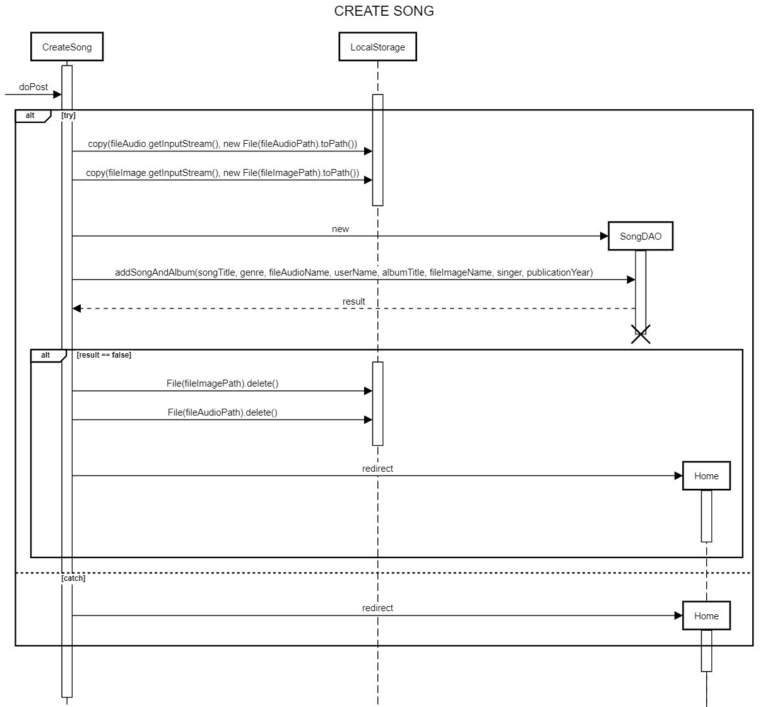

Slide 16
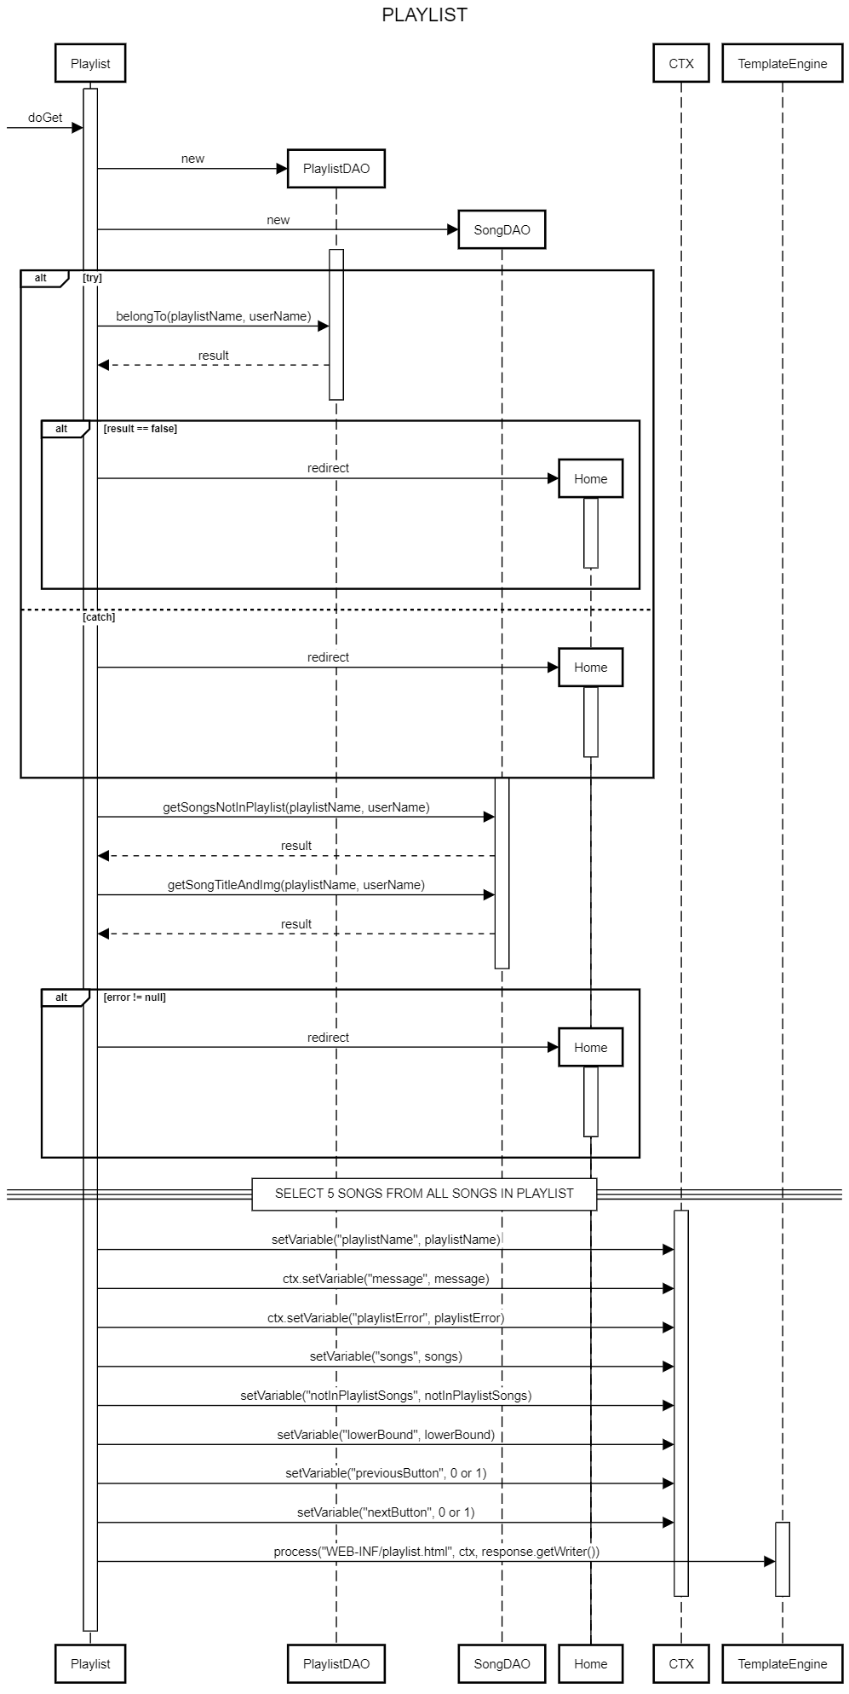

Slide 17
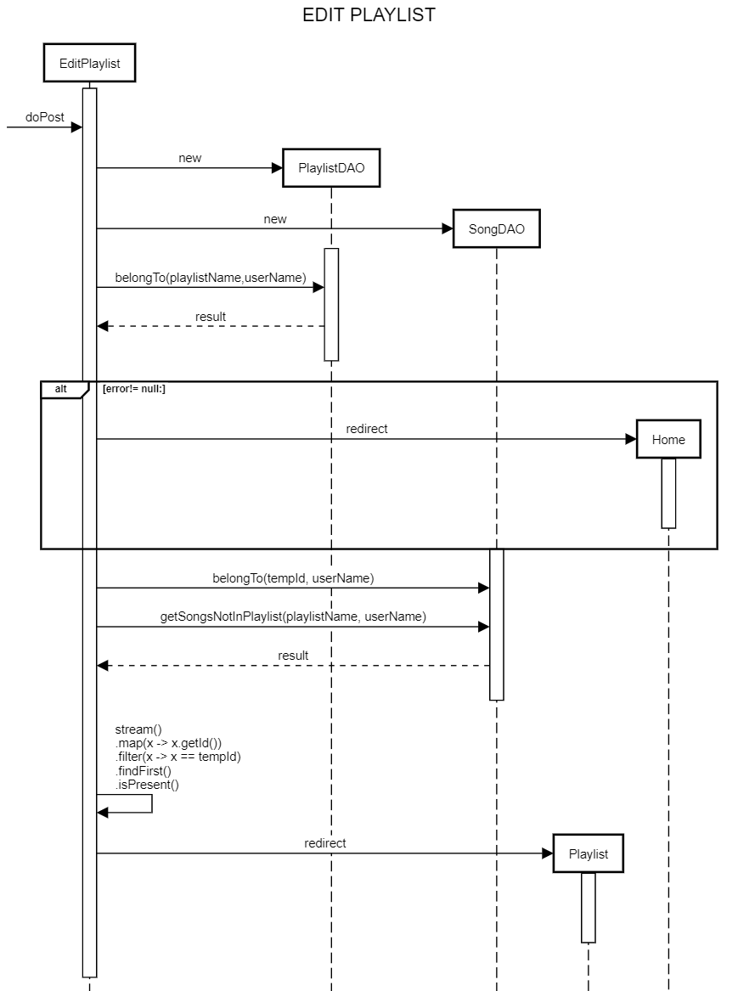

Slide 18
